Slide 1
BCS1520: Statistics
Lecture 03:
RCTs and Causality
Anirudh Wodeyar

Slide 2
Population and sample
Population: a set of instances “of interest”
Sample: a set of instances sampled from the population
Say, we want to compute an average household income per person (incl. kids) in the Netherlands:
Population: all households in the Netherlands
Sample:

Slide 3
Population and sample
Population: a set of instances “of interest”
Sample: a set of instances sampled from the population
Say, we want to compute an average household income per person (incl. kids) in the Netherlands:
Population: all households in the Netherlands
Sample: households that we can reach given timeline/budget/consent/…
How do we make conclusions about the whole population based on the sample?

Slide 4
Population and sample
Population: a set of instances “of interest”
Sample: a set of instances sampled from the population
Say, we want to compute an average household income per person (incl. kids) in the Netherlands:
Population: all households in the Netherlands
Sample: households that we can reach given timeline/budget/consent/…
Can we make conclusions about the whole population based on the sample? How?

Slide 5
Population and sample
Inductive inference: drawing conclusions about the unknown or unobserved instances based on limited observed data.
How can we estimate how our new video recommendation algorithm will work when we launch it for all users?
1. Possible Data
2. Sample
3. Study Population
4. Target Population
Notes:
Induction is about taking particular instances and trying to work out general conclusions. For example, suppose we don’t know the customs in a community about kissing female friends on the cheek, and we have to try to work it out by observing whether people kiss once, twice, three times, or not at all. The crucial distinction is that deduction is logically certain, whereas induction is generally uncertain.

Slide 6
Population and sample
Inductive inference: drawing conclusions about the unknown or unobserved instances based on limited observed data.
How can we estimate how our new video recommendation algorithm will work when we launch it for all users?
1. Possible Data
2. Sample
3. Study Population
4. Target Population
All possible user interactions the algorithm could provoke and we can measure:
clicks, watch time, skips, likes, shares, across all users and videos.
Notes:
Induction is about taking particular instances and trying to work out general conclusions. For example, suppose we don’t know the customs in a community about kissing female friends on the cheek, and we have to try to work it out by observing whether people kiss once, twice, three times, or not at all. The crucial distinction is that deduction is logically certain, whereas induction is generally uncertain.

Slide 7
Population and sample
Inductive inference: drawing conclusions about the unknown or unobserved instances based on limited observed data.
How can we estimate how our new video recommendation algorithm will work when we launch it for all users?
1. Possible Data
2. Sample
3. Study Population
4. Target Population
The data collected from a limited group of users: logs during online experiment on small group of users.
Notes:
Induction is about taking particular instances and trying to work out general conclusions. For example, suppose we don’t know the customs in a community about kissing female friends on the cheek, and we have to try to work it out by observing whether people kiss once, twice, three times, or not at all. The crucial distinction is that deduction is logically certain, whereas induction is generally uncertain.

Slide 8
Population and sample
Inductive inference: drawing conclusions about the unknown or unobserved instances based on limited observed data.
How can we estimate how our new video recommendation algorithm will work when we launch it for all users?
1. Possible Data
2. Sample
3. Study Population
4. Target Population
The user population represented by the sample: statistical measures like mean session time, click-through rate, and their variability.
Notes:
Induction is about taking particular instances and trying to work out general conclusions. For example, suppose we don’t know the customs in a community about kissing female friends on the cheek, and we have to try to work it out by observing whether people kiss once, twice, three times, or not at all. The crucial distinction is that deduction is logically certain, whereas induction is generally uncertain.

Slide 9
Population and sample
Inductive inference: drawing conclusions about the unknown or unobserved instances based on limited observed data.
How can we estimate how our new video recommendation algorithm will work when we launch it for all users?
1. Possible Data
2. Sample
3. Study Population
4. Target Population
All platform users after launch: including new users, different regions, new content types, and future behavior patterns.
Notes:
Induction is about taking particular instances and trying to work out general conclusions. For example, suppose we don’t know the customs in a community about kissing female friends on the cheek, and we have to try to work it out by observing whether people kiss once, twice, three times, or not at all. The crucial distinction is that deduction is logically certain, whereas induction is generally uncertain.

Slide 10
What do we want from our measurements?
For inductive inference to work, measurements (metrics and their values) must be reliable enough to generalize and valid enough to generalize to the right thing.
Reliable: Low variability across instances (metrics) given same context
Valid: Measuring what you intend to measure, or at least close to it.
In our video recommendation example:
Reliable: engagement metrics (e.g., watch time, click-through rate) should be stable for similar users in similar situations. Large fluctuations indicate noise rather than true performance differences.
Valid: Session time may be influenced by autoplay or video length and may not fully reflect user satisfaction or content quality.

Slide 11
Internal validity
Are the observed effects (values of metrics) actually caused by what we think caused them?
Differences in watch time are due to the new recommendation algorithm, not:
time of day
user cohort imbalance
novelty effects
logging changes
How to ensure that when we conduct an online experiment?

Slide 12
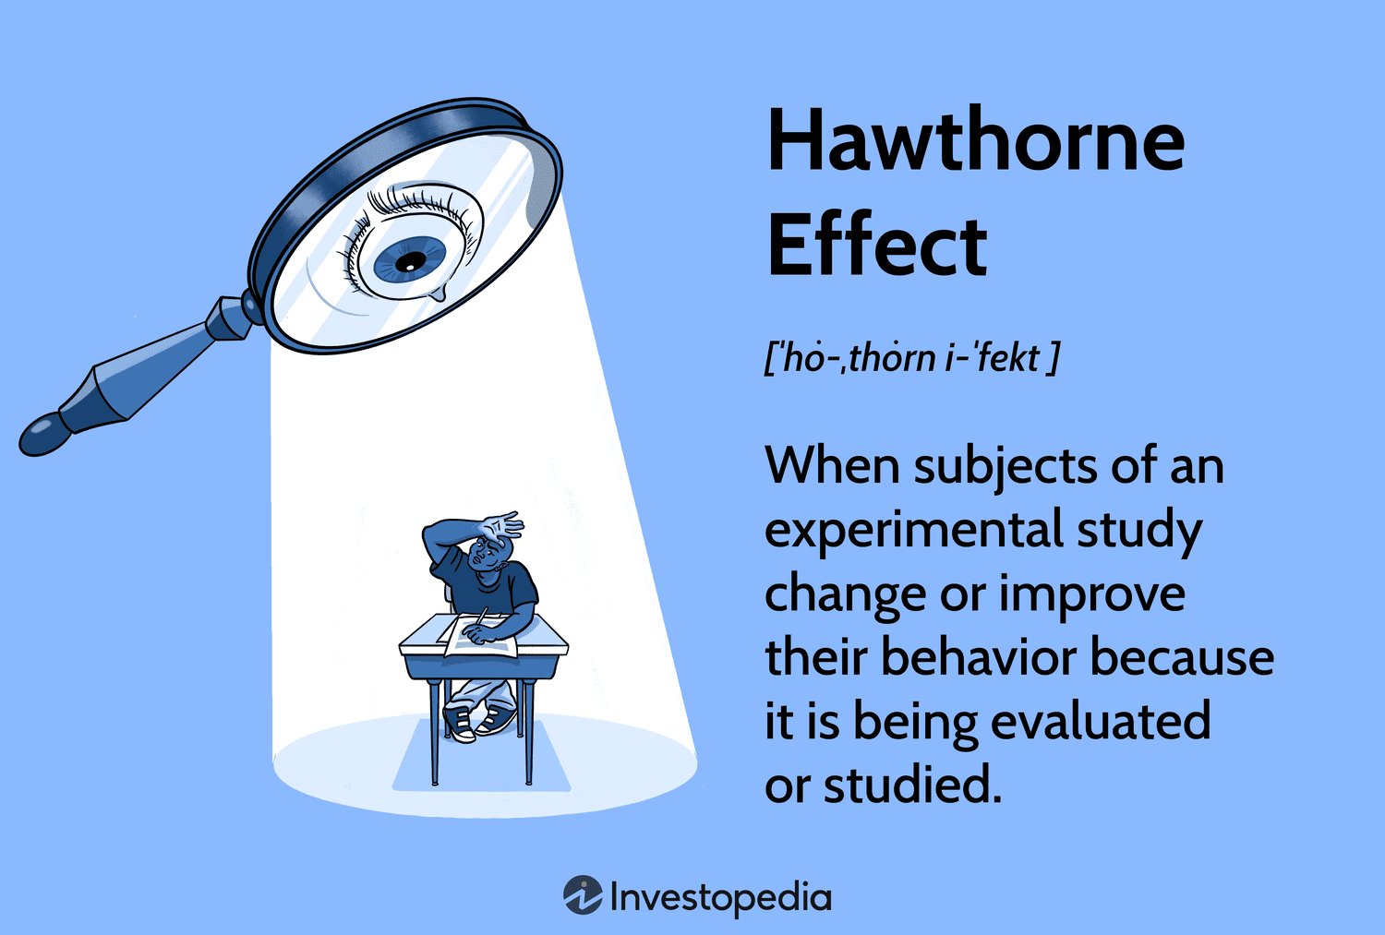
Lack of Internal Validity
Bias in machine learning algorithms that try to sort resumes/CVs
An Instagram video gets more likes because it was posted at 9pm, not because it’s better content.
A game update seems to increase playtime, but it launched during school holidays.

Slide 13
External validity
Do the conclusions from this study actually generalize to target population?
We evaluate our video recommendation algorithm on a sample of users
We expect the observed performance to generalize to all users after launch
How to ensure that when we conduct an online experiment?

Slide 14
Lack of External Validity
If in a survey to assess dietary choices, we only polled men.
Or, if we are testing a new drug, but only tested them on mice. Might be good at judging the study population, but not the target population.

Slide 15
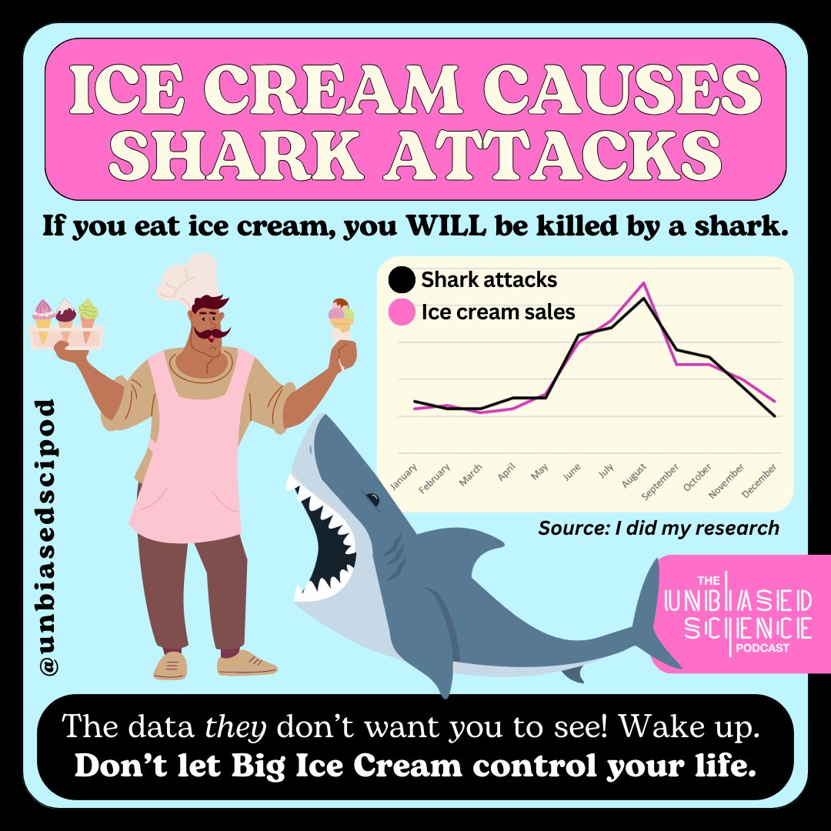
Shark attacks and Ice Cream
Unbiased Science Podcast

Slide 16
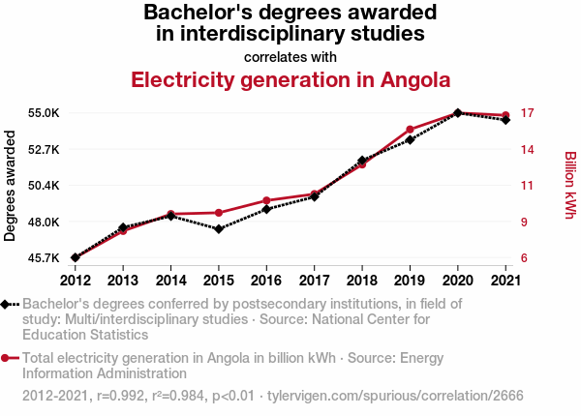
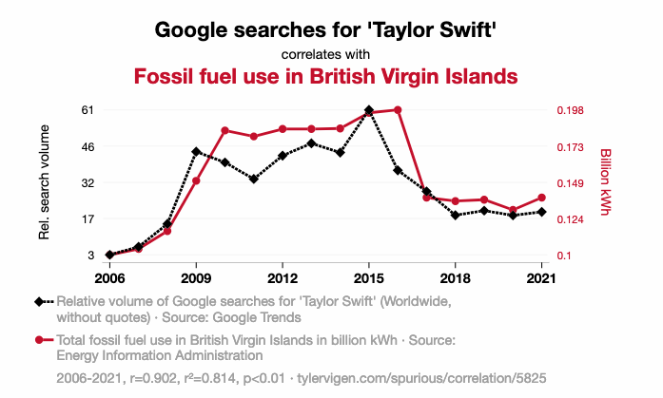
Interesting correlations
What is correlation? What is causation?
Tyler Vigen: Spurious Correlations

Slide 17
Correlations types
Correlation is a statistical measure expressing the extent to which two variables relate and change together.
How do we quantify correlation between variables:
Pearson’s correlation: measures linear relationships
Spearman’s correlation: measures monotonic relationships using ranks

Slide 18
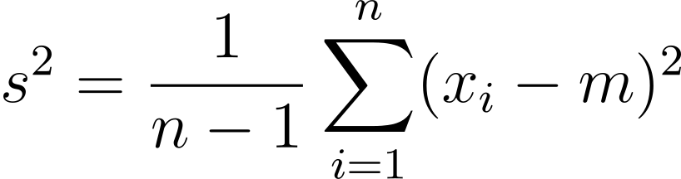
Covariance
Covariance: how do variables vary together?
Measures whether two variables increase or decrease together
Positive: move in the same direction
Negative: move in different directions
Zero: no linear movement
Recap: Sample variance
How far are measurements from population mean

Slide 19
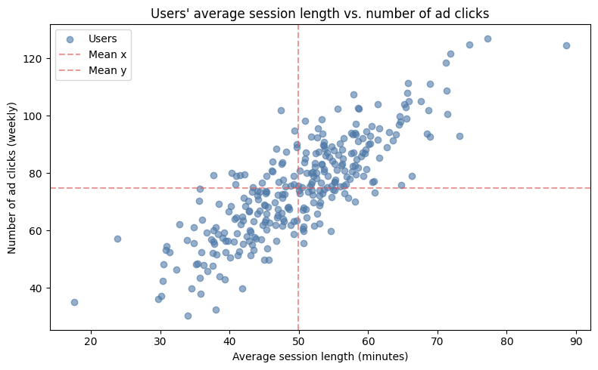
Covariance
Recap: Sample variance
How far are measurements from population mean
Average watching session length vs number of ad clicks: how do we compute variance for each?

Slide 20
Covariance
Recap: Sample variance
How far are measurements from population mean
Assume we want to compute variances of average session lengths per user and number of ad clicks:
(90, 121)
(90, 121)
(50, 79)
(50, 79)
(19,39)
(19, 39)

Slide 21
Covariance
Covariance: how do variables vary together?
Measures whether two variables increase or decrease together
Positive: move in the same direction
Negative: move in different directions
Zero: no linear movement
(90, 121)
(50, 79)
(19,39)

Slide 22
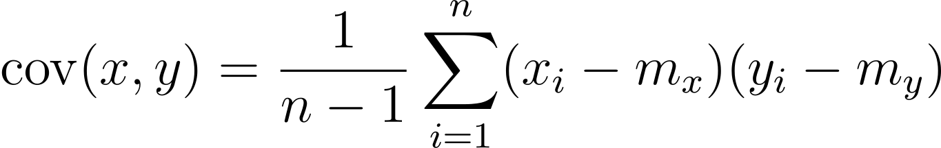
Covariance
Covariance: how do variables vary together?
Measures whether two variables increase or decrease together
Positive: move in the same direction
Negative: move in different directions
Zero: no linear movement
(90, 121)
Covariance between users’ average session length and number of ad clicks for the dataset: 141.46
(50, 79)
(19,39)

Slide 23
Covariance
Compute covariance for:
x = [2, 4, 6, 9, 12]
y = [14, 17, 22, 43, 52]

Slide 24
Covariance
Main issue with covariance: it depends on the scale (units) of the variables and is unbounded, making values hard to interpret and compare.
Compute covariance for:
x = [2, 4, 6, 9, 12]
y = [14, 17, 22, 43, 52]
Answer: 65.55
Compute covariance for:
x = [20, 40, 60, 90, 120]
y = [140, 170, 220, 430, 520]
Answer: 6555
Compute covariance for:
x = [200, 400, 600, 900, 1200]
y = [1400, 1700, 2200, 4300, 5200]
Answer: 655500
How do we obtain a bounded, unit-free measure? We normalize!

Slide 25
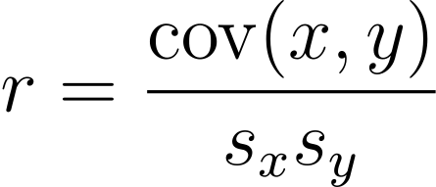
Pearsons’s correlation
Pearson’s correlation (Pearson’s r) measures the strength of a linear relationship between two paired numerical variables and is within [-1, 1]:
1: perfect positive correlation
0: no correlation
-1: perfect negative correlation

Slide 26
Pearsons’s correlation
Compute Pearson’s correlation:
x = [2, 4, 6, 9, 12, 15]
y = [14, 17, 22, 43, 52]
Compute Pearson’s correlation:
x = [20, 40, 60, 90, 120, 150]
y = [140, 170, 220, 430, 520]

Slide 27
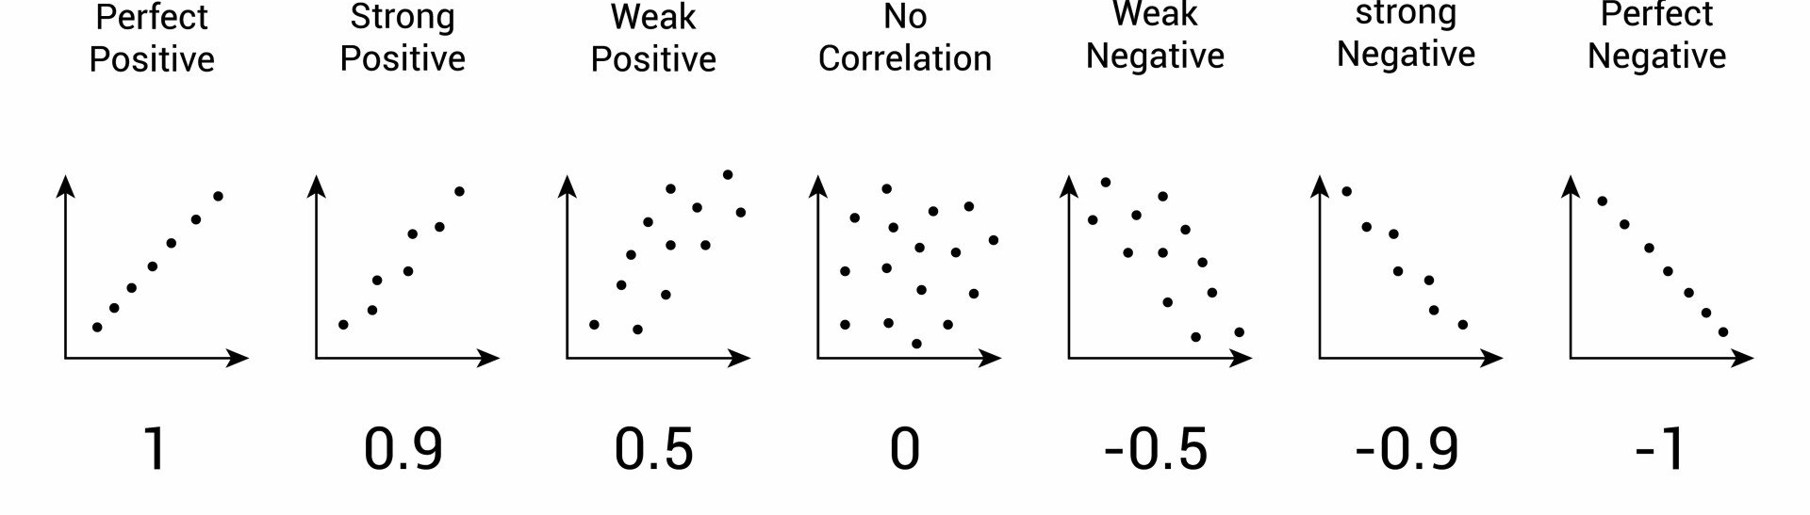
Pearsons’s correlation
Pearson’s correlation and scatters:

Slide 28
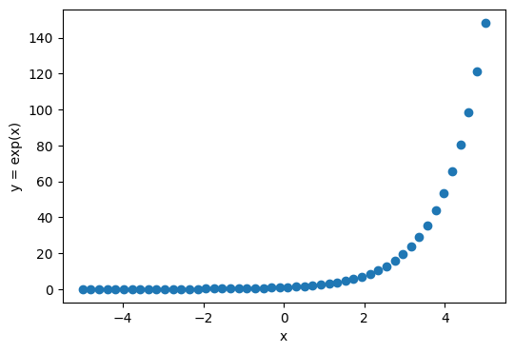
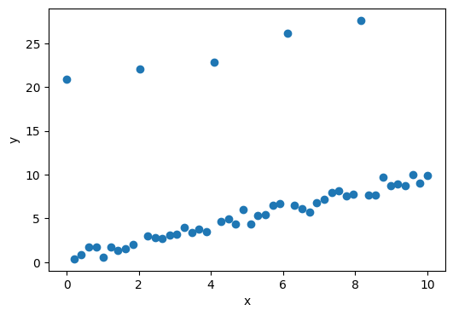
Pearsons’s correlation
Guess the correlation game: https://www.guessthecorrelation.com/

Slide 29
Pearsons’s correlation
Guess the correlation game: https://www.guessthecorrelation.com/
Pearson’s correlation: 0.689
Pearson’s correlation: 0.338

Slide 30
Pearsons’s correlation
Pearson’s correlation (Pearson’s r) measures the strength of a linear relationship between two paired numerical variables
Pearson’s correlation is not an optimal metric when a relationship cannot be explained with a linear function
Pearson’s correlation: 0.689
Pearson’s correlation: 0.338

Slide 31
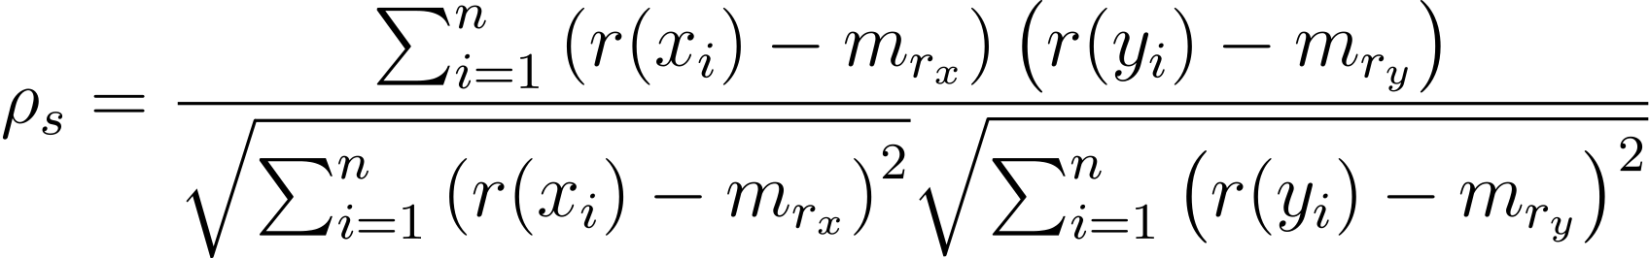
Spearman’s Correlation
Spearman’s rank correlation (Spearman’s ⍴) is computed by:
replacing the original values of each variable with their ranks
computing Pearson’s correlation on those ranks.

Slide 32
Spearman’s Correlation
Spearman’s rank correlation (Spearman’s ⍴) is computed by:
replacing the original values of each variable with their ranks
computing Pearson’s correlation on those ranks.
Covariance of ranks
x ranks std
y ranks std
x = [3, 1, 13, 7, 9, 10, 4]
y = [81, 1, 28561, 2401, 6561, 10000, 256]
rank(x) = [2, 1, 7, 4, 5, 6, 3]
rank(y) = [2, 1, 7, 4, 5, 6, 3]
Compute Spearman’s and Pearson’s correlation.

Slide 33
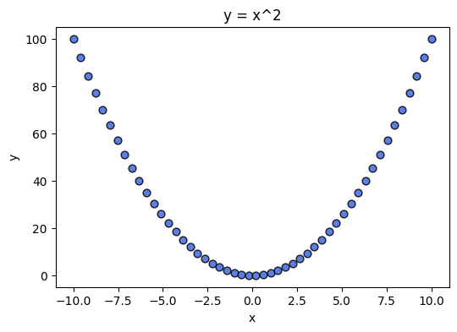
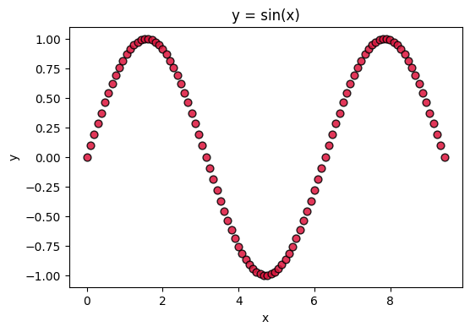
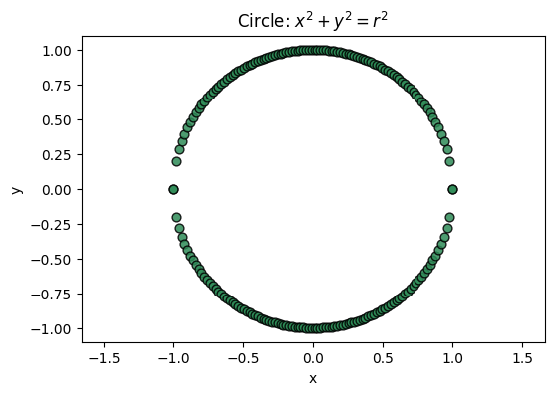
Correlations
Guess the correlations:

Slide 34
Pearsons’s correlation
How do we quantify correlation between variables:
Pearson’s correlation: measures linear relationships
Spearman’s correlation: measures monotonic relationships using ranks
Pearson’s correlation for all plots: ~0
Sperman’s correlation for all plots: ~0
But there is clearly a pattern!

Slide 35
Correlation analysis
Independent variable (x): variable that is fixed by design or observation and whose association with and outcome is of interest
Dependent variable (y): The outcome that we are probably measuring to understand how the independent variable influences it.
Pearson correlation coefficient: 0.831
Spearman rank correlation coefficient: 0.813
It is also possible to evaluate whether correlation values are statistically significant.
We will talk about statistical significance later in the course.
Notes:
Fossil fuel use is not reall a dependent variable here.

Slide 36
Correlation vs Causation
Does high correlation imply causation?
Causation means that one event or variable directly produces a change in another.
Correlation only tells us that two variables move together (positively or negatively). It does not tell us why they move together.
Notes:
summer

Slide 37

Going to university increases risks of Brain Tumors
Huge study with millions of subjects revealed that men/women with university degrees were associated with 19%/23% higher risks to get tumours.
Who do you think gets better medical care?
“Completeness of cancer registration and detection bias are potential explanations for the findings”
Notes:
So far we’ve been considering the numerical relationships, but causality is something we can think about for exposure as well – that is, for proportions.
Clearly you should all drop out.

Slide 38
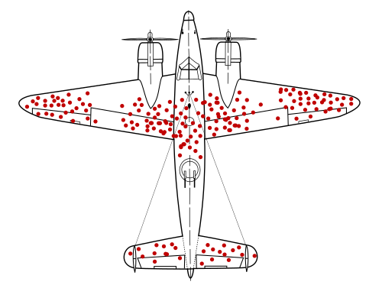
How to lose less war planes?
During World War II, the Statistical Research Group at Columbia University (New York) was examining the damage done to aircraft that had returned from missions and had to recommend which areas should be armored better.
Correlation observed in the data: Returning planes have many bullet holes in the wings and few in the engine.
Causal claim: Being hit in the wings causes planes to be damaged and lost.
Plot of the damage on the returned planes
Notes:
So far we’ve been considering the numerical relationships, but causality is something we can think about for exposure as well – that is, for proportions.
Clearly you should all drop out.

Slide 39
How to lose less war planes?
During World War II, the Statistical Research Group at Columbia University (New York) was examining the damage done to aircraft that had returned from missions and had to recommend which areas should be armored better.
Correlation observed in the data: Returning planes have many bullet holes in the wings and few in the engine.
Causal claim: Being hit in the wings causes planes to be damaged and lost.
Correct causal question: Which bullet locations cause planes not to survive?
Plot of the damage on the returned planes
Selection (survivorship) bias: conditioning on survival creates misleading correlations that are not causal.
Notes:
So far we’ve been considering the numerical relationships, but causality is something we can think about for exposure as well – that is, for proportions.
Clearly you should all drop out.

Slide 40
What is causation?
A challenging philosophical problem: starting from Aristotle…
But also, experientially easy to define, that is, we each know for ourselves when we cause something.
And that’s the definition that statistics uses: If you do something that changes something else, then that points to a causal link.
Statistical Causation:
When we say that T causes Y, we do not mean that every time T occurs, then Y will too.
Or that Y will only occur if T occurs.
We simply mean that if we intervene and force T to occur, then Y tends to happen more often. We can never say that T caused Y in a specific case, only that T increases the proportion of times that Y happens.
Treatment T
Outcome Y
Notes:
Starting from Aristotle all the way to the modern day, there are many views on causation.

Slide 41
Kids and causal experimentation
The idea that is at the core of intelligence: competence without comprehension as a result of causal intervention.
You do a thing and see if it changes anything. And keep doing that.
Kids are great at doing this to understand the world!
Notes:
Making sounds.

Slide 42
What is causation?
If, for patient X, we apply Treatment T to that changes Y, with some consistency, then that points to a causal link.
How can we be sure though?
For example, if a medicine is prescribed and the patient is recovered, we assume the medicine caused it to happen.
But how do I know that this wouldn’t have happened anyway?
Patient X
Treatment T
Outcome Y

Slide 43
Randomization: The Heart of Causal Analysis
When we randomize over who gets a treatment or not, we make the potential outcomes independent of the treatment.
This means that the group given treatment and group not given treatment are comparable.
This sounds confusing but really all it is saying is there’s no bias in who is receiving treatment.
Testing a new vaccine:
Control group: Placebo
Treatment group: New vaccine
Placebo (fake vaccine)
Vaccine

Slide 44
Randomized Control Trials
As a Computer Scientist, why do I care about Randomized Control Trials for vaccination?
Because you will likely need to test new hypotheses (algorithm versions, methods, etc.) , and for this we need RCT-like procedures (online experiments, A/B tests, hypothesis testing, etc.)
Notes:
As elucidated in the second chapter, comprehending the impact of unseen confounding factors when measuring treatment effects on an outcome is challenging. One way to address this issue is through randomized controlled trials, which introduce randomness in the treatment allocation process and ensure that the resulting groups (binary and ) are comparable, thus mitigating the confounding impact. In other words, randomization ensures exchangeability, i.e., the treatment groups are entirely interchangeable because of the randomization. Thus the average outcome of the two groups and remain the same. From a causal graph perspective, the randomized treatment removes the edge between the confounder and the treatment , removing the backdoor path and the confounding association.

Slide 45
Randomized Control Trials
Controls.
Allocation of Treatment.
People should be counted in the groups they were assigned to.
People should be blinded to their group.
Groups should be equally treated.
People doing the final assessment shouldn’t know which group the subjects are in.
Measure everyone.

Slide 46
Randomized Control Trials
Controls: We need to give the vaccine to some and not to others. This group not getting the vaccines should not know they don’t get the vaccine but a placebo.
Allocation of Treatment.
People should be counted in the groups they were assigned to.
People should be blinded to their group.
Groups should be equally treated.
People doing the final assessment shouldn’t know which group the subjects are in.
Measure everyone.

Slide 47
Randomized Control Trials
Controls
Allocation of Treatment: Randomly allocate participants to treatment and control. Accounts for unknown unknowns.
People should be counted in the groups they were assigned to.
People should be blinded to their group.
Groups should be equally treated.
People doing the final assessment shouldn’t know which group the subjects are in.
Measure everyone.

Slide 48
How do we allocate groups?
Our goal is to minimize the possibility of introducing some hidden variable that affects the outcome and is different in two groups (control and treatment).
Sampling techniques:
Non-probability sampling: convenience, snowball, judgement, volunteer sampling
Simple Random Sampling
Stratified Sampling
…
Notes:
Sampling relevant outside of RCTs as well.

Slide 49
Sampling Techniques
Non-probability sampling: no randomness (probability) in sampling:
Convenience sampling: use all available samples… convenient
Snowball sampling: future samples are selected based on existing samples (e.g. social network connections)
Judgement sampling: experts decide which samples to include
Volunteer sampling: when we have and need consent from volunteers (medical applications)

Slide 50
Sampling Techniques
Simple Random Sampling: all samples are chosen randomly to be selected for each group
Stratified Sampling: divide study population into categories and sample from each group separately (e.g. Adults/Kids) to ensure equal representation of each category in control and treatment groups

Slide 51
Sampling Techniques
Simple Random Sampling: all samples are chosen randomly to be selected for each group.
Stratified Sampling: divide study population into categories and sample from each group separately (e.g. Adults/Kids) to ensure equal representation of each category in control and treatment groups
Placebo (fake vaccine)
Vaccine

Slide 52
Sampling Techniques
Simple Random Sampling: all samples are chosen randomly to be selected for each group
Stratified Sampling: divide study population into categories and sample from each group separately (e.g. Adults/Kids) to ensure equal representation of each category in control and treatment groups
Stratify

Slide 53
Sampling Techniques
Simple Random Sampling: all samples are chosen randomly to be selected for each group
Stratified Sampling: divide study population into categories and sample from each group separately (e.g. Adults/Kids) to ensure equal representation of each category in control and treatment groups
Stratify and sample

Slide 54
Randomized Control Trials
Controls
Allocation of Treatment
People should be counted in the groups they were assigned to. Even if they don’t get the vaccine in the end. Measures the act of prescription (less relevant for vaccines).
People should be blinded to their group.
Groups should be equally treated.
People doing the final assessment shouldn’t know which group the subjects are in.
Measure everyone.

Slide 55
Randomized Control Trials
Controls
Allocation of Treatment: Randomly allocate participants to treatment and control. (a randomized controlled trial or RCT).
People should be counted in the groups they were assigned to.
People should be blinded to their group. So that they don’t do more risky activities assuming they have immunity.
Groups should be equally treated.
People doing the final assessment shouldn’t know which group the subjects are in.
Measure everyone.

Slide 56
Levels of Blinding
Single-blinding: Participants
Double-blinding: Participants + People monitoring.
Triple-Blinding: Participants + People monitoring + Statisticians.

Slide 57
Randomized Control Trials
Controls
Allocation of Treatment: Randomly allocate participants to treatment and control. (a randomized controlled trial or RCT).
People should be counted in the groups they were assigned to.
People should be blinded to their group.
Groups should be equally treated. People getting treatment shouldn’t be examined more or vice-versa.
People doing the final assessment shouldn’t know which group the subjects are in.
Measure everyone.

Slide 58
Randomized Control Trials
Controls
Allocation of Treatment: Randomly allocate participants to treatment and control. (a randomized controlled trial or RCT).
People should be counted in the groups they were assigned to.
People should be blinded to their group.
Groups should be equally treated.
People (clinicians, statisticians, data scientists) doing the final assessment shouldn’t know which group the subjects are in. This could bias the people doing the final assessment into not paying careful attention to vaccinated. Double-blinding.
Measure everyone.

Slide 59
Clinical Trial Principles
Controls
Allocation of Treatment: Randomly allocate participants to treatment and control. (a randomized controlled trial or RCT).
People should be counted in the groups they were assigned to.
People should be blinded to their group.
Groups should be equally treated.
People doing the final assessment shouldn’t know which group the subjects are in.
Measure everyone. Perhaps some people leave the study from side effects, you especially want to capture that.

Slide 60
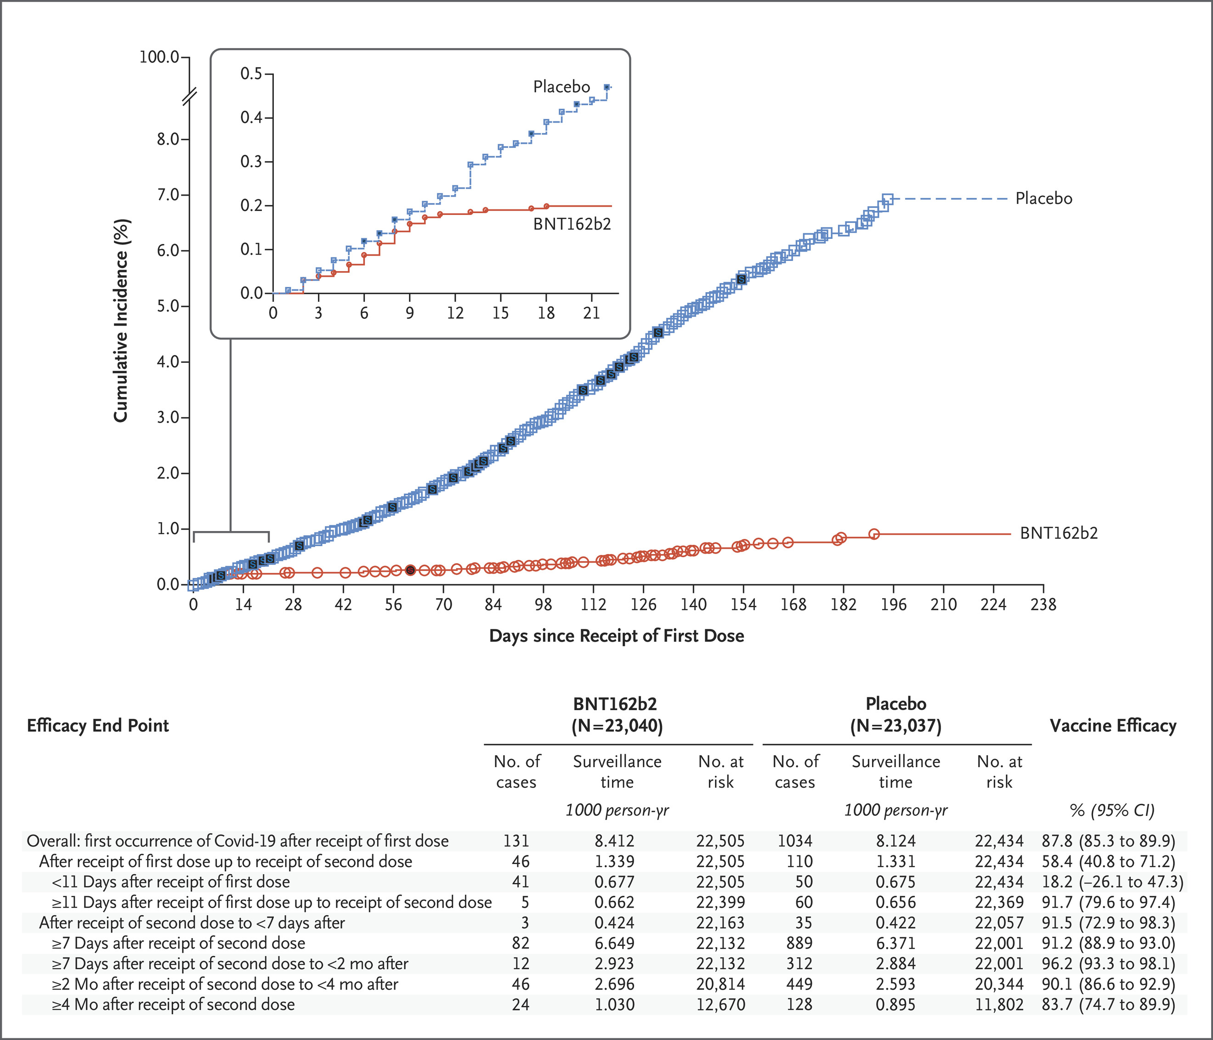
Evaluate the effects
After the data is collected we can use statistical tools to analyze the results:
How do we know that the results are likely not due to chance? We use statistical (hypothesis) testing to compare metrics obtained for two samples. (We will cover some tests in the lecture on hypothesis testing)
“Vaccine efficacy was calculated as 100×(1–IRR), where IRR (incidence rate ratio) is the ratio of the rate (number per 1000 person-years of follow-up) of confirmed cases of Covid-19 in the BNT162b2 group to the corresponding rate in the placebo group. The 95% confidence interval for vaccine efficacy was derived with the use of the Clopper–Pearson method, with adjustment for surveillance time.”
Thomas, Stephen J., et al. "Safety and efficacy of the BNT162b2 mRNA Covid-19 vaccine through 6 months." New England Journal of Medicine 385.19 (2021): 1761-1773.
Notes:
You were 10 times less likely to get the COVID infection if you had a vaccination (mRNA).

Slide 61
Can we be sure the previous plot was not due to chance?
RCTs are our best attempt to remove doubt about a causal link between an intervention and an outcome.
Here, the clinical trial involved tens of thousands of participants and then the outcomes were compared using proper statistical inference tools.
So, we are sure to certain extent that this was not due to chance.

Slide 62
What if we can’t randomize?
For example: we can’t randomize who gets Alzheimer’s (a neurodegenerative disease) and who doesn’t.
So then, how can we figure out what causes Alzheimer’s disease? Assume it is related to say, neurons dying in the brain.

Slide 63
What if we can’t randomize?
Prospective cohort study: Follow people through their lives and measure neuron death through their life and assess whether they get Alzheimer’s later in life.
Retrospective cohort study: Can you find ways to identify whether a group of elderly subjects, some with and some without Alzheimer’s had neuron death earlier in life? Say by looking at other medical records.
Case-control study: Find subjects who have and don’t have Alzheimer’s and are matched in age, socioeconomic status and so on and assess neuron death across them.

Slide 64
What if we can’t randomize?
Cross-sectional study: when analysis is based solely on the current state of individuals, without any follow-up over time or treatment assignment.
For example: Why do people in Data Analysis who know Python earn more?
We can’t randomly assign people to learn Python.
With the cross-sectional study we can measure the correlation.

Slide 65
Returning to the sharks and ice cream
There is something common and confounding in here: summer.
People are more likely to go to the beach in the summer so they are more likely to be attacked by sharks.
People are also more likely to eat ice cream in the summer.
So we could analyse the correlation on days with similar warm temperature.

Slide 66
Confounders
A confounding variable (confounding factor, confound, lurking variable, or confounder), is a variable that is positively or negatively associated with both the dependent variable and an independent variable.
Game: find a confounder!
Independent X: Use of AI coding tools Dependent Y: Programming productivity
Notes:
This is also a good example of scientific malpractice as the doctor who published the article had money to gain (from test kits for a fake disease) from suggesting MMR vaccines caused autism.

Slide 67
Confounders
A confounding variable (confounding factor, confound, lurking variable, or confounder), is a variable that is positively or negatively associated with both the dependent variable and an independent variable.
Game: find a confounder!
Independent X: Video recommendation algorithm Dependent Y: Average session time watching videos
Notes:
This is also a good example of scientific malpractice as the doctor who published the article had money to gain (from test kits for a fake disease) from suggesting MMR vaccines caused autism.

Slide 68
Confounders
A confounding variable (confounding factor, confound, lurking variable, or confounder), is a variable that is positively or negatively associated with both the dependent variable and an independent variable.
Game: find a confounder!
Independent X: Tutorials attended Dependent Y: Final course grade

Slide 69
Gender bias in Graduate Admissions
Controlling for confounds: When there are differences between groups in observational studies, we can try adjusting for them: called controlling for the confounds/lurking factors, e.g. summer.
Case study from UC, Berkeley:
8442 men and 4321 women applied to UC, Berkeley during study period
44% of men and 35% of women admitted
Seems like men are preferred.

Slide 70
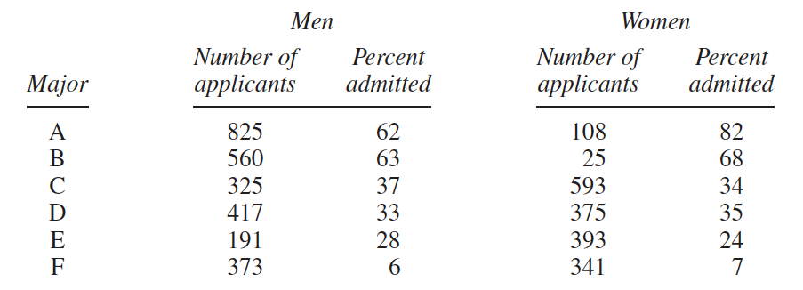
Sex bias in Graduate Admissions
Controlling for confounds: How to control for this, though?
Notes:
But then, it looks like in every major there is a bias towards women really, or at least a limited bias towards them, here we have tried to correct for a confound and found that there was a reversal of the result.
The first two majors were easy to get into. Over 50% of the men applied to these two majors.
• The other four majors were much harder to get into. Over 90% of the women applied to these four majors.

Slide 71
Simpson’s Paradox
When relationships between percentages in subgroups can be reversed when the subgroups are combined.
In the graduate admission case, weighting by relative number of applicants within each program gives us 39% for men and 44% for women.

Slide 72
Simpson’s paradox

Slide 73
Causation and Counterfactuals
But how do I know that this wouldn’t have happened anyway?
This is called a counterfactual: there exists a world where the patient recover even without treatment.
This defies our understanding of the world of course, but this is useful statistical reasoning.
Patient X
Treatment T
Outcome Y

Slide 74
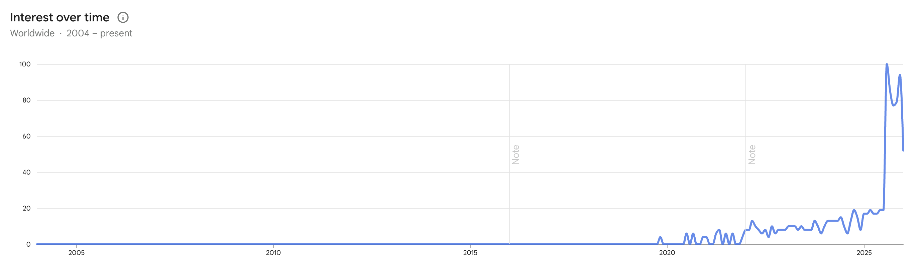
What is causation?
What’s the main challenge with counterfactuals?
Counterfactuals are like the metaphorical populations: useful fictions that let us make better data-driven decisions.
Defining cause based on intervention is difficult in real-life: the counterfactuals can’t actually occur, and then we need statistics.
Heavily used in Explainable AI literature in the recent years
Counterfactual explanations (Explainable AI)

Slide 75

Causation
Good popular science book that makes a strong case for why causal analysis is the bedrock of understanding the world.

Slide 76
Causal Analysis from Observational Data: Horwick et al.
Direct Evidence
Size of effect is so so large that it cannot be explained by plausible confounding.
There is appropriate temporal and/or spatial proximity, in that cause precedes effect and effect occurs after a plausible interval, and/or cause occurs at the same site as the effect.
Dose responsiveness and reversibility: the effect increases as the exposure increases, and the evidence is even stronger if the effect reduces upon reduction of the dose.

Slide 77
Causal Analysis from Observational Data: Horwick et al.
Mechanistic Evidence
There is a plausible mechanism of action: this may be biological, chemical, mechanical or quantum. There is external evidence of a causal chain.
This approach relies on being able to come up with a scientific explanation based on past research and a chain of logic that leads us to believe in the causal effect from observational data.

Slide 78
Causal Analysis from Observational Data: Horwick et al.
3. Parallel Evidence
The effect fits with what is known already.
The effect is found when the study is replicated.
The effect is found in similar, but not identical, studies.
For example, mouth ulcers have been observed to occur after aspirin is rubbed within the mouth, say to relieve tooth pain. The effect is dramatic (1a), occurs where rubbed (1b), is a plausible response to an acidic compound (2), is not contradicted by current science and is similar to the known effect of aspirin in causing stomach ulcers (3a), and has been repeatedly observed in multiple patients (3b). So five out of seven guidelines are satisfied, the remaining two have not been tested, and so it is reasonable to conclude this is a genuine adverse reaction to the drug.

